Slide 1
SCS101 LECTURE 2
INTRODUCTION TO PROGRAMMING (CONTINUATION)
Prepared by:
Nekesa

Slide 2
PROGRAMMING ERRORS/BUGS
Syntax error-it results as a violation of rules and procedures of writing a program e.g omission of a semicolon
Semantic errors-It is the violation of the meaning inscribed in a particular term.
Logical error-program is running properly but giving undesired results or doesn’t make sense.
Compilation/Run-time/Execution time error-This error happens when compiling a program e.g division by zero i.e 5/0

Slide 3
Programming Language Generations
1GL or first-generation language was (and still is) machine language or the level of instructions and data that the processor is actually given to work on.
2GL or second-generation language is assembler (sometimes called "assembly") language.
3GL or third-generation language is a "high-level" programming language, such as PL/I, C, or Java. A compiler converts the statements of a specific high-level programming language into machine language.
4GL or fourth-generation language is designed to be closer to natural language than a 3GL language. Languages for accessing databases are often described as 4GLs.
5GL or fifth-generation language is programming that uses a visual or graphical development interface to create source language that is usually compiled with a 3GL or 4GL language compiler.
Microsoft, Borland, IBM, and other companies make 5GL visual programming products for developing applications in Java, for example.
Visual programming allows you to easily envision object-oriented programming class hierarchies and drag icons to assemble program components.

Slide 4
Integrated Development Environment (IDE)
An IDE or Integrated Development Environment is a software program that is designed to help programmers and developers build software. Most IDEs include: a source code editor, a compiler, build automation tools and a debugger
The process of editing, compiling, running, and debugging programs is often managed by a single integrated application known as an Integrated Development Environment, or IDE for short.
An IDE is a windows-based program that allows us to easily manage large software programs, edit files in windows, and compile, link, run, and debug programs
Under Windows, Microsoft Visual Studio is a good example of a popular IDE

Slide 5
Program Development Process
The program development life cycle is a set of steps or phases that are used to develop a program in any programming language.
Generally, program development life cycle contains 6 phases, they are as follows….
Problem Definition
Problem Analysis
Algorithm Development
Coding & Documentation
Testing & Debugging
Maintenance

Slide 6
Program Development Process
1. Problem Definition
In this phase, problem statement is defined and the boundaries of the problem. In this phase we need to understand the problem statement, what is our requirement, what should be the output of the problem solution. These are defined in this first phase of the program development life cycle.
2. Problem Analysis
In phase 2, we determine the requirements like variables, functions, etc. to solve the problem. That means we gather the required resources to solve the problem defined in the problem definition phase. We also determine the bounds of the solution.
3. Algorithm Development
During this phase, we develop a step by step procedure to solve the problem using the specification given in the previous phase. This phase is very important for program development. That means we write the solution in step by step statements.
4. Coding & Documentation
This phase uses a programming language to write or implement actual programming instructions for the steps defined in the previous phase. In this phase, we construct actual program. That means we write the program to solve the given problem using programming languages like C, C++, Java etc.,
5. Testing & Debugging
During this phase, we check whether the code written in previous step is solving the specified problem or not. That means we test the program whether it is solving the problem for various input data values or not. We also test that whether it is providing the desired output or not.
6. Maintenance
During this phase, the program is actively used by the users. If any enhancements found in this phase, all the phases are to be repeated again to make the enhancements. That means in this phase, the solution (program) is used by the end user. If the user encounters any problem or wants any enhancement, then we need to repeat all the phases from the starting, so that the encountered problem is solved or enhancement is added.

Slide 7
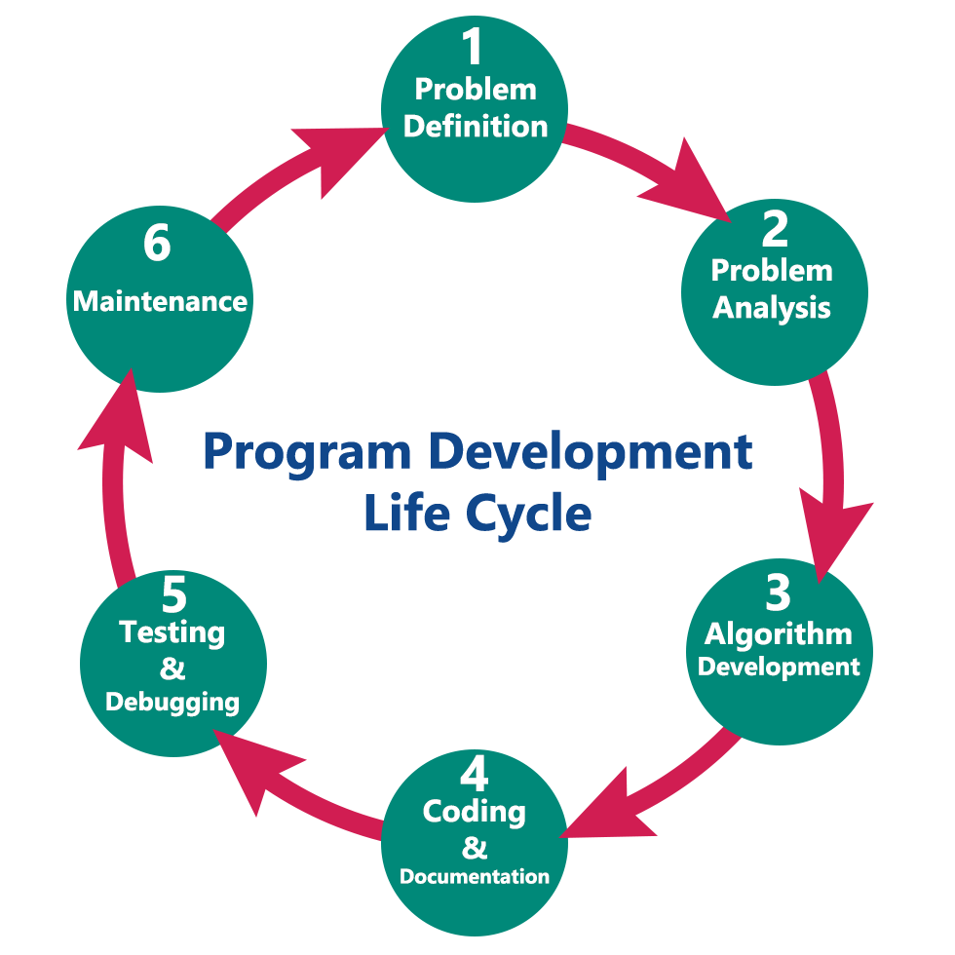
Program Development Process

Slide 8
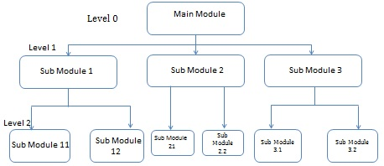
Design Strategies
Top-Down Strategy
The top-down strategy uses the modular approach to develop the design of a system.
It is called so because it starts from the top or the highest-level module and moves towards the lowest level modules.
In this technique, the highest-level module or main module for developing the software is identified.
The main module is divided into several smaller and simpler submodules or segments based on the task performed by each module. Then, each submodule is further subdivided into several submodules of next lower level. This process of dividing each module into several submodules continues until the lowest level modules, which cannot be further subdivided, are not identified.

Slide 9
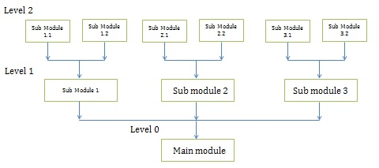
Design Strategies cont…..
Bottom-Up Strategy
Bottom-Up Strategy follows the modular approach to develop the design of the system.
It is called so because it starts from the bottom or the most basic level modules and moves towards the highest level modules.
In this technique, The modules at the most basic or the lowest level are identified.
These modules are then grouped together based on the function performed by each module to form the next higher-level modules.
Then, these modules are further combined to form the next higher-level modules.
This process of grouping several simpler modules to form higher level modules continues until the main module of system development process is achieved.

Slide 10
PROGRAM TRANSLATION
C-Systems generally consists of several parts, namely:
Program development environment (IDE)
Language
C-Standard library

Slide 11
C-program development process
C-Programs go through six phases to be executed
Editing-This is accomplished with an editor program e.g Ms Visual studio ,Borland, C++ builder e.t.c The Programmer types a c-program with the editor, makes correction if necessary, then stores programs on a secondary storage devices such as a disk. C-program file names should end with the .c extension edit
Pre-Process-The processor program executes automatically before the compiler translation phase begins. The C-preprocessor directives which indicate that certain manipulations are to be performed on the program before compilation.
a preprocessor is a program that processes its input data to produce output that is used as input to another program.
The output is said to be a preprocessed form of the input data, which is often used by some subsequent programs like compilers.
The amount and kind of processing done depends on the nature of the preprocessor; some preprocessors are only capable of performing relatively simple textual substitutions and macro expansions, while others have the power of full-fledged programming languages.

Slide 12
Cont:
3. Compilation phase- The programmer gives the command to compile the program. The compiler translates the high level language(source code) into machine language(object code).Interpreter-illustrates code to operating system. i.e translates one programming language to another.
4. Linking- C-programs typically contain differences to functions defined elsewhere such as in the standard library or in private libraries groups of programmers working on a particular project.
Linker-Links the object code with the source code to ensure no missing functions to produce an executable program(no missing pieces)

Slide 13
Cont.
5. Loading phase- Before the program can be executed the program must first be placed in the memory, this is done by the loader.
Loader takes the executable image from the disk and transfers it to the memory. Additional components from shared libraries that support the program are also loaded.
6. Executing phase- The compiler under the control of its control processing unit, executes the program/instructions at a time. Execution
NB: Programs don’t always work on first try. Each of preceding phases can fail due to various errors.

Slide 14
EVOLUTION OF PROGRAMMING LANGUAGE AND TECHNIQUES OF PROGRAMMING
Unstructured Programming: It consists of a set of statements executed from top to bottom (in order)
Structured Programming (Modular programming): Its used to divide large applications into a set of procedures that can be used to perform a certain task. A program is subdivided into small programs called modules that can be solved independently. It was used in large [programming and also called bottom-up programming.
Procedural programming: This emphasizes on the design of a program using a given procedure. A procedure is used to solve certain task.
Object oriented programming: The aspect of writing programs using objects and classes.
Event Driven programming: is a programming paradigm in which the flow of program execution is determined by events -

Slide 15
CHARACTERISTICS/FEATURES OF PROGRAMMING LANGUAGES
Clarity of the source code-The ability of the code to be readable, understandable and also reflect the logical structure of the program.
Maintainability- Ability to modify a program in future
Portability- The ability of the program to be transferred from one hardware/software programs to another e.g From windows to unix or linux system
Reliability- This is the ability of the language to perform their intended function satisfactorily through out their expected time of the process.
Expressivity- understandable and readable
Generality- Features of a programming language should remain constant e.g when you want to print to the screen, we use printf which is used all through in programming.
Operability- Ability of the program to operate on different platforms.

Slide 16
ALGORITHM
This is step by step procedure of solving a problem, attaining a goal or accomplishing a certain objectives or verifying a problem has been solved.
A step-by-step (a set of) instructions which when followed will produce a solution to a given problem.
Characteristics of a good algorithm
Definiteness- Each step of an algorithm must be clearly defined or the action must clearly specified.
Finiteness- An algorithm must terminate (end) after a number of steps.
Efficiency- Algorithms must be effective, or operations are executable, avoid ambiguity.
Input
Output

Slide 17
Program design Tools.
Algorithms can be illustrated using the following tools:
Pseudocodes.
Flowcharts.
Decision Tables.
Decision Trees.
Note. For any given problem, the programmer must choose which algorithm (method) is best suited to solve it.

Slide 18
1. Pseudocode-
This is an artificial and informal language that helps programmers develop algorithms.It is similar to every day English.
A pseudocode is a method of documenting a program logic in which English-like statements are used to describe the processing steps.
These are structured English-like phrases that indicate the program steps to be followed to solve a given problem.
It is convenient and user friendly although its not actual computer programming language. This helps programmers “thinking out” a program before putting it in actual coding.

Slide 19
Cont.
Guidelines for designing a good pseudocode.
The statements must be short, clear and readable.
The statements must not have more than one meaning (i.e., should not be ambiguous).
The pseudocode lines should be clearly outlined and indented.
A pseudocode must have a Begin and an end.
i.e., a pseudocode should show clearly the start and stop of executable statements and the control structures.
The input, output and processing statements should be clearly stated using keywords such as PRINT, READ, INPUT

Slide 20
EXAMPLE 1
Write a pseudocode that can be used to prompt the user to enter two numbers, calculate the sum and average of the two numbers and then display the output on the screen.
Solution
START
PRINT “Enter two numbers”
INPUT X, Y
Sum = X + Y
Average = Sum/2
PRINT Sum
PRINT Average
STOP

Slide 21
Example 2:
Write a structured algorithm that would prompt the user to enter the Length and Width of a rectangle, calculate the Area and Perimeter, then display the result.
Solution
Step 1: Draw the rectangle of Length (L) and Width (W).
Step 2: Write down the Pseudocode.
START
PRINT “Enter Length and Width”
READ L, W
Area = L * W
Perimeter = 2 (L + W)
PRINT Area
PRINT Perimeter
STOP

Slide 22
Example 3:
Write a pseudocode that can be used to calculate the Diameter, Circumference and Area of a circle and then display the output on the screen.
Solution
START
Set π to 3.14
Prompt the user for the Radius (R)
Store the radius in a variable (R)
Set Diameter to 2 * Radius
Set Circumference to π * 2 * Radius
Set Area to π * Sqr (Radius)
PRINT Diameter
PRINT Circumference
PRINT Area
STOP

Slide 23
Example 4:
Write a pseudocode for a program that would be used to solve equation: E = MC².
Solution
START
Enter values from M to C
E = M * C * C
Display E
stop
It is important to use program control structures when writing Pseudocodes. The most common constructs are:
Looping (Repetition / Iteration) – used where instructions are to be repeated under certain conditions.
Selection – used when choosing a specified group of instructions for execution. The group chosen depends on certain conditions being satisfied.

Slide 24
Example 5:
Write a pseudocode for a program that can be used to classify people according to age. If a person is more than 20 years; output “Adult” else output “Young person”.
Solution
START
PRINT “Enter the Age”
INPUT Age
IF Age > 20 THEN
PRINT “Adult”
ELSE
PRINT “Young person”
STOP
Note. Pseudocodes make an algorithm easier to understand. This is because; the algorithm can be read from top to bottom without the need for jumping backwards or forwards to follow the logic of the algorithm as in flowcharts.

